Slide 1

The Safety Of Women’s (FemmeFortress)
Meet FemmeFortress: an innovative initiative crafted using MERN Stack Technology, dedicated to ensuring the safety of women. With distinct modules for administrators and users, FemmeFortress offers efficient and reliable security solutions. Join us as we redefine safety protocols and empower women worldwide.

Slide 2
Proposed System
1.User Friendly Access
Through user friendly web interface can easily submit the complaints
2.Complaint Management
Only authorized persons can manage the complaints such as6t76t Director or Mentors
3.Data Security & Encryption
It will be protect against unauthorized access
4.Development
The system is developed in MERN stack with ease of maintenance

Slide 3
Need of the Project
Empowering Women’s
Promote Safety
Quick Response

Slide 4
Scope of the Project
Strong System
For efficiently manage complaints
Secure Access
Secure registration, login and users can submit complaints
User Friendly Interface

Slide 5
Objectives of the Project
Supportive Environment
Prioritize Women's Safety
Simplifying Complaint Submission
Privacy Protection
Immediate Complaint Facility
Provide Easy Admin Access

Slide 6
Requirement Analysis
Collect User Requirements
one-on-one conversations with a women
Hold group discussions with stakeholders
Observe users interacting with similar applications
Functional Requirements
Account Management
Reporting Capabilities
Safety Features
Dashboards and data displays for administrators
Usability Assessment
Create layout with user-friendly controls.
Provide options for users to easily report issues

Slide 7
Diagrams
Activity Diagram:

Slide 8
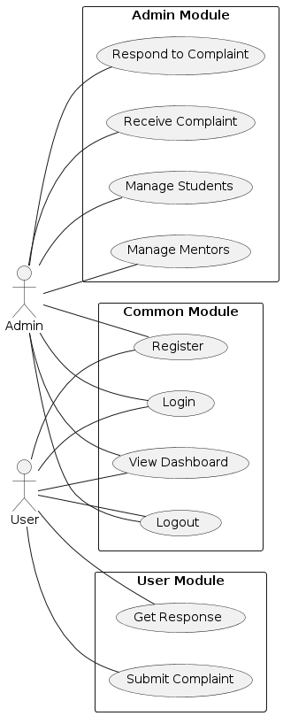
Use Case Diagram:

Slide 9
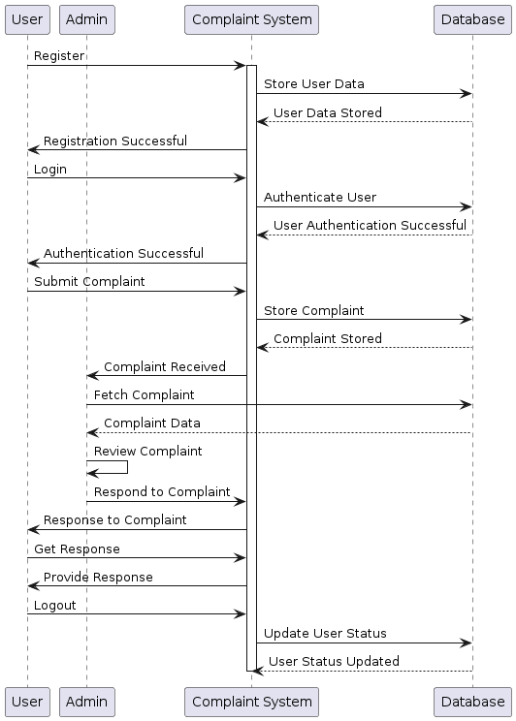
Sequence Diagram:

Slide 10
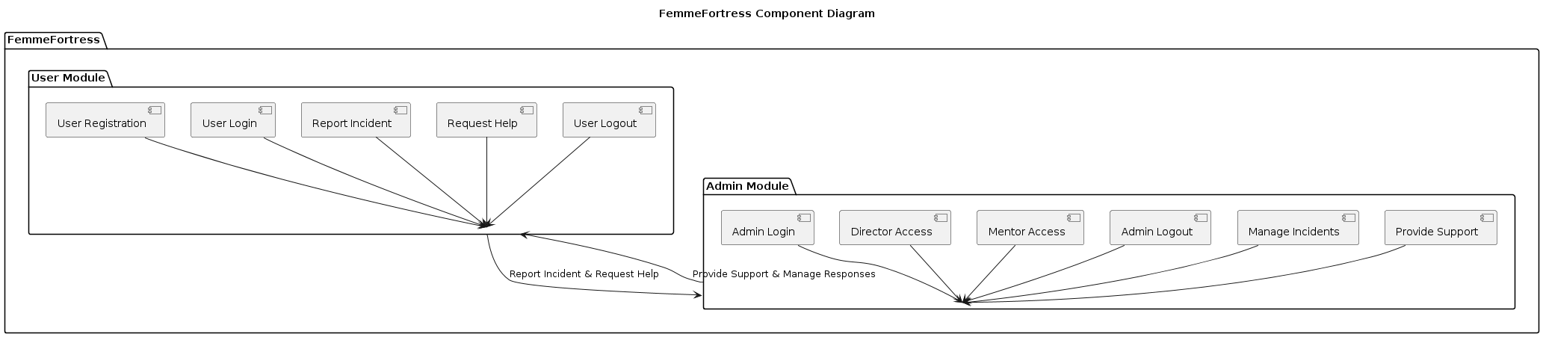
Component Diagram:

Slide 11
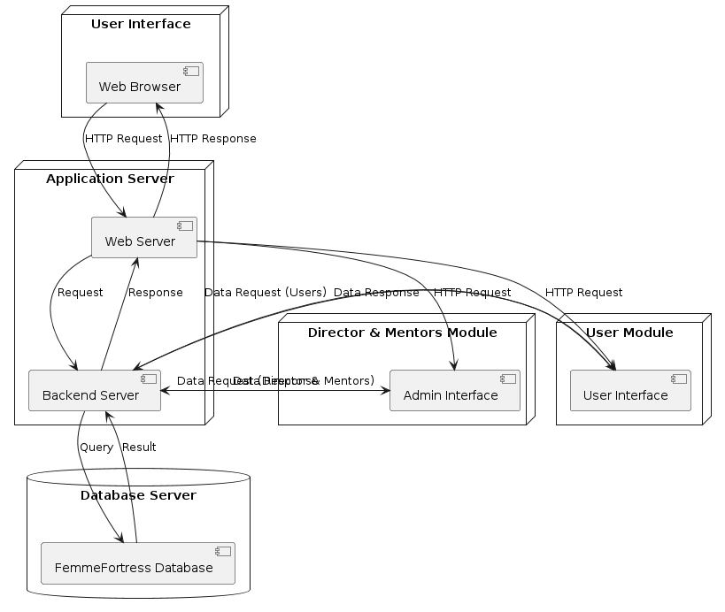
Deployment Diagram:

Slide 12
Database Designs
Collection Name : signupdetails
Collection Name : logindetails
Field | Data Type
Name | String
Email | String
MentorName | String
Department | String
Password | String
Field | Data Type
email | String
password | String

Slide 13
Collection Name : contactdetails
Collection Name : complaintdetails
Field | Data Type
Name | String
Email | String
Message | String
Field | Data Type
FullName | String
Email | String
MobileNumber | Number
Complaint | String

Slide 14
Collection Name: dashsignupdetails
Collection Name: dashlogindetails
Field | Data Type
FirstName | String
LastName | String
Email | String
Password | String
Field | Data Type
Email | String
Password | String

Slide 15
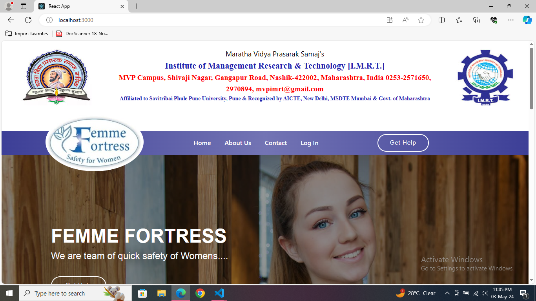
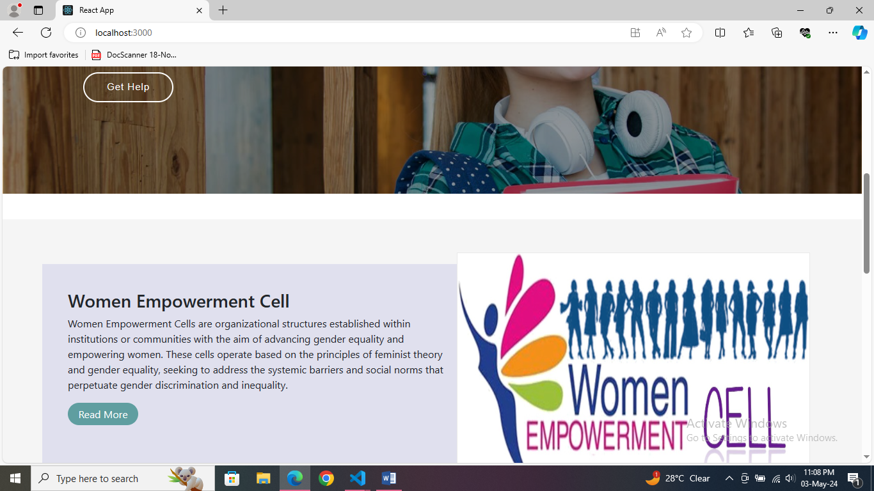
Interface Design (Input/ Output Screens)

Slide 16
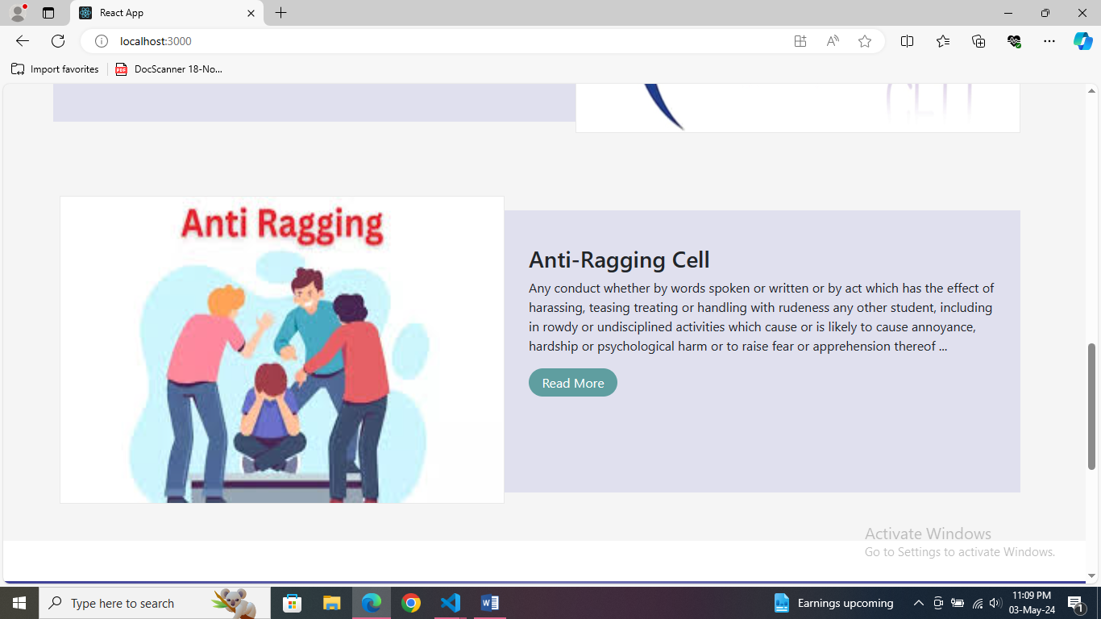
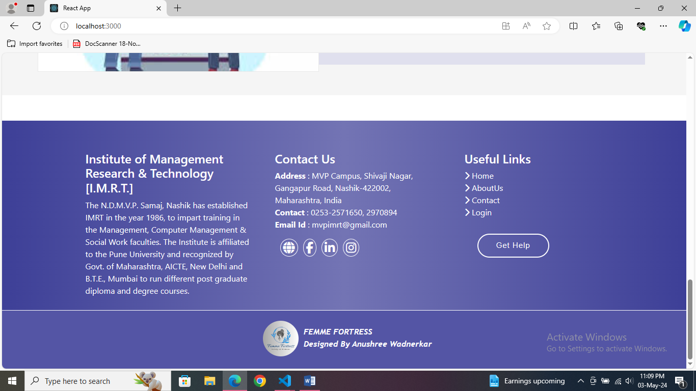

Slide 17
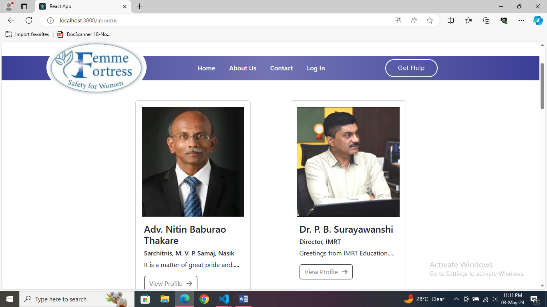
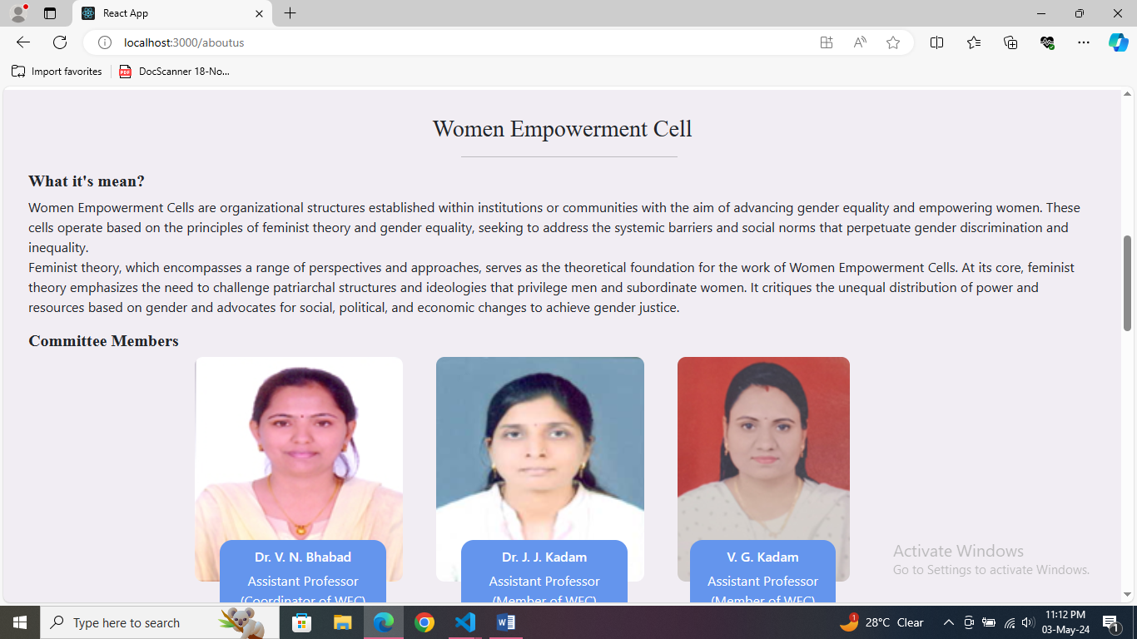
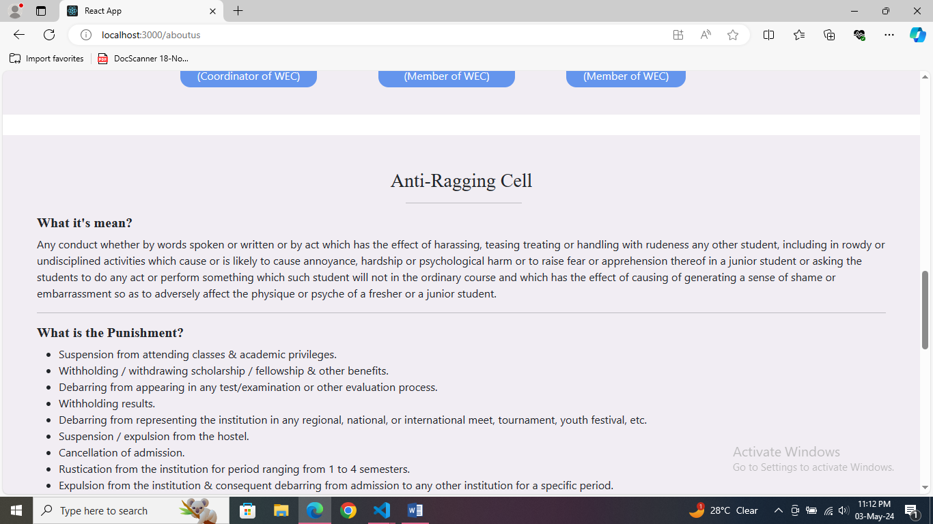
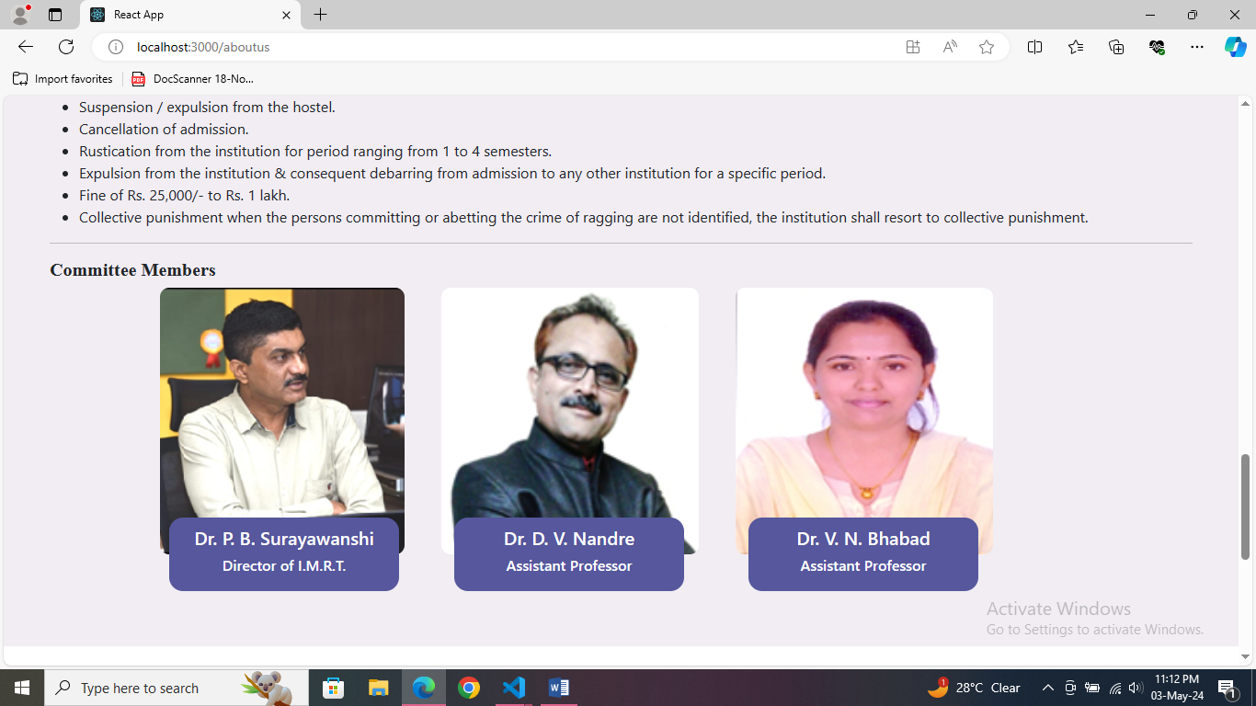

Slide 18
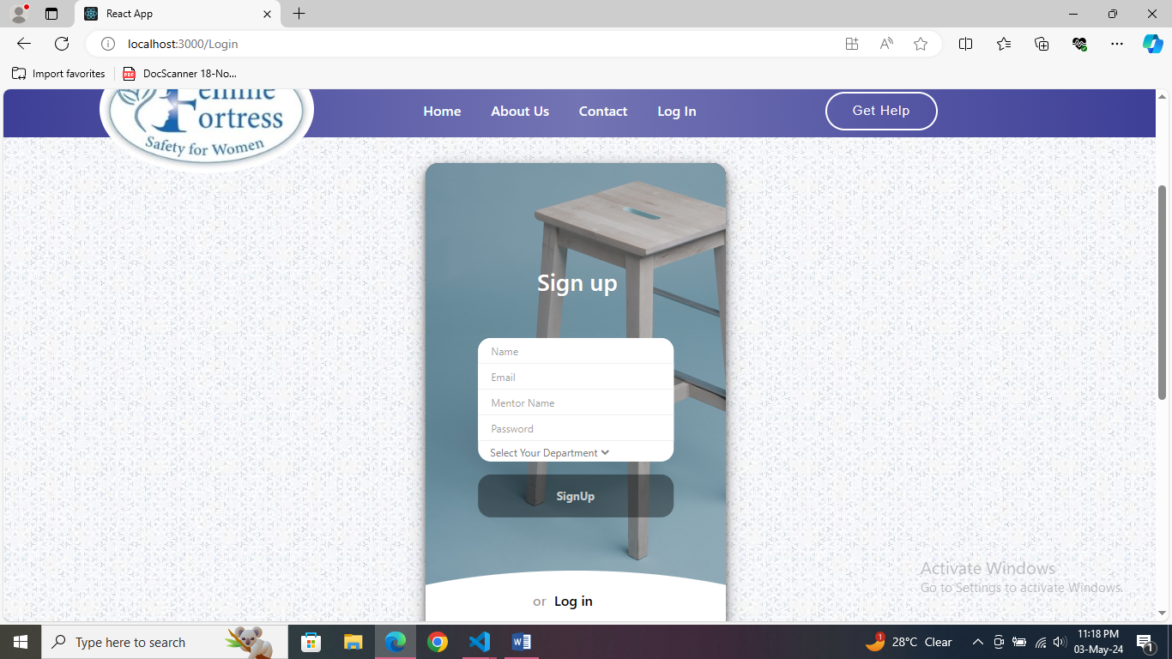
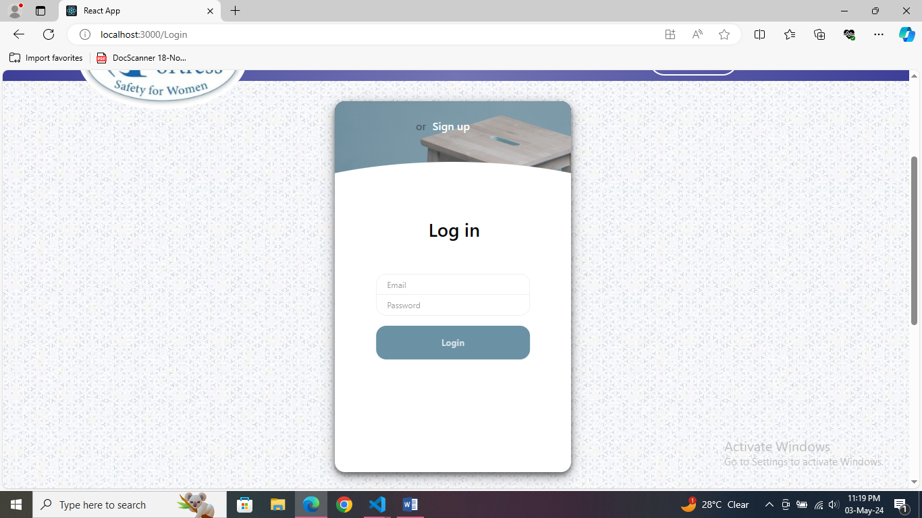

Slide 19
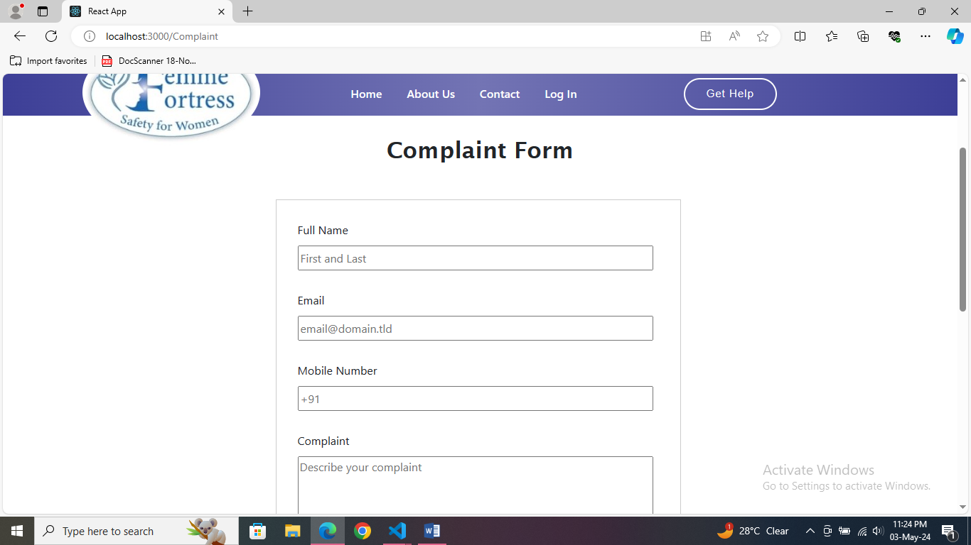
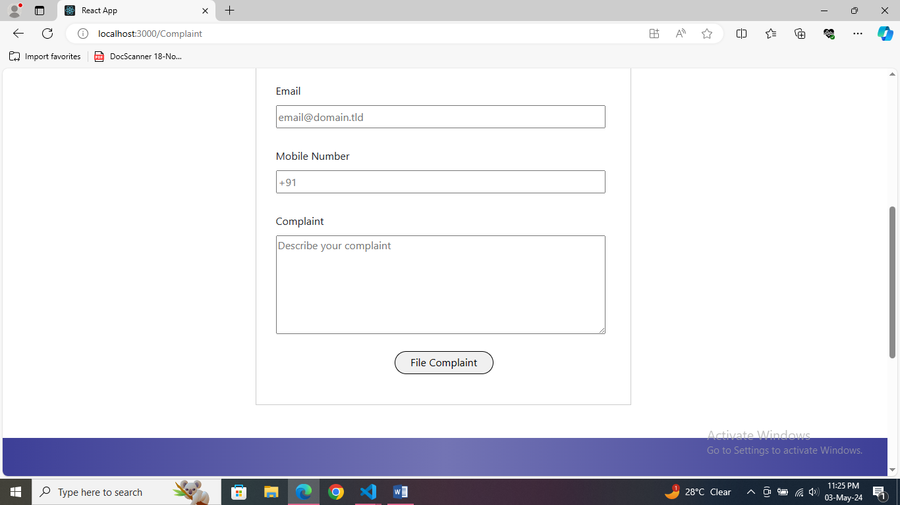

Slide 20
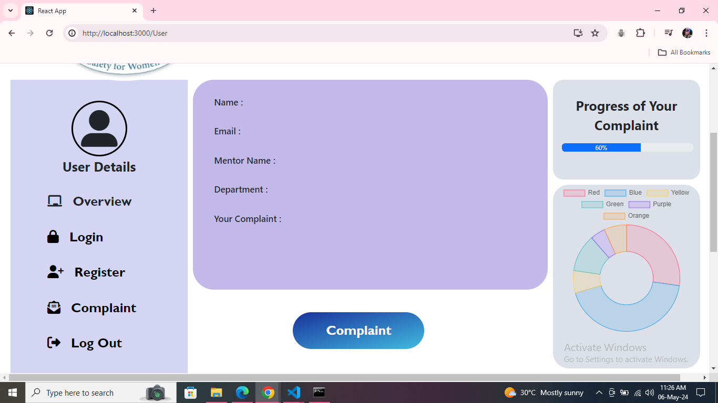

Slide 21
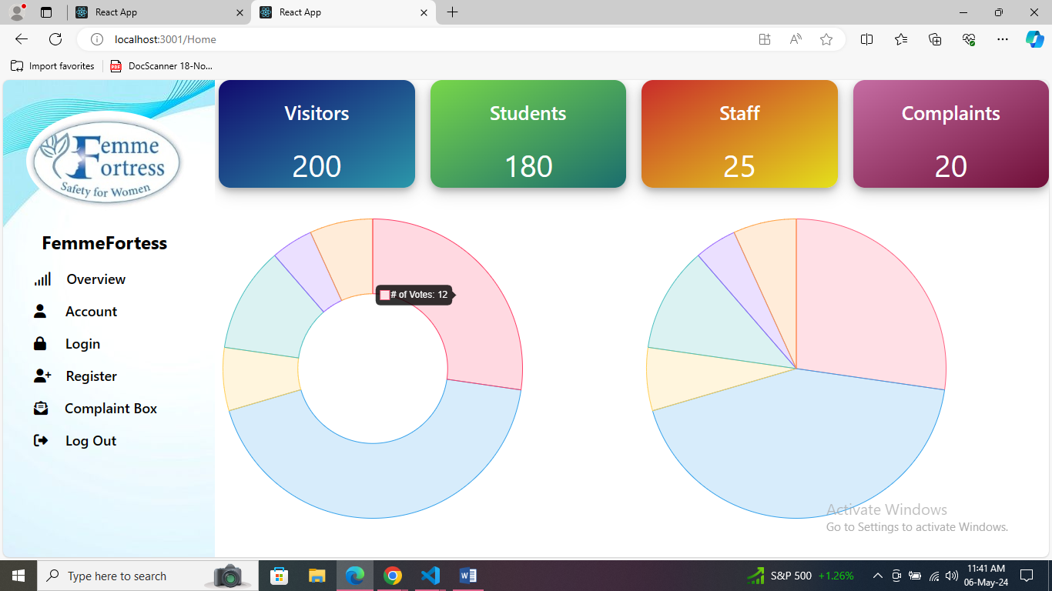
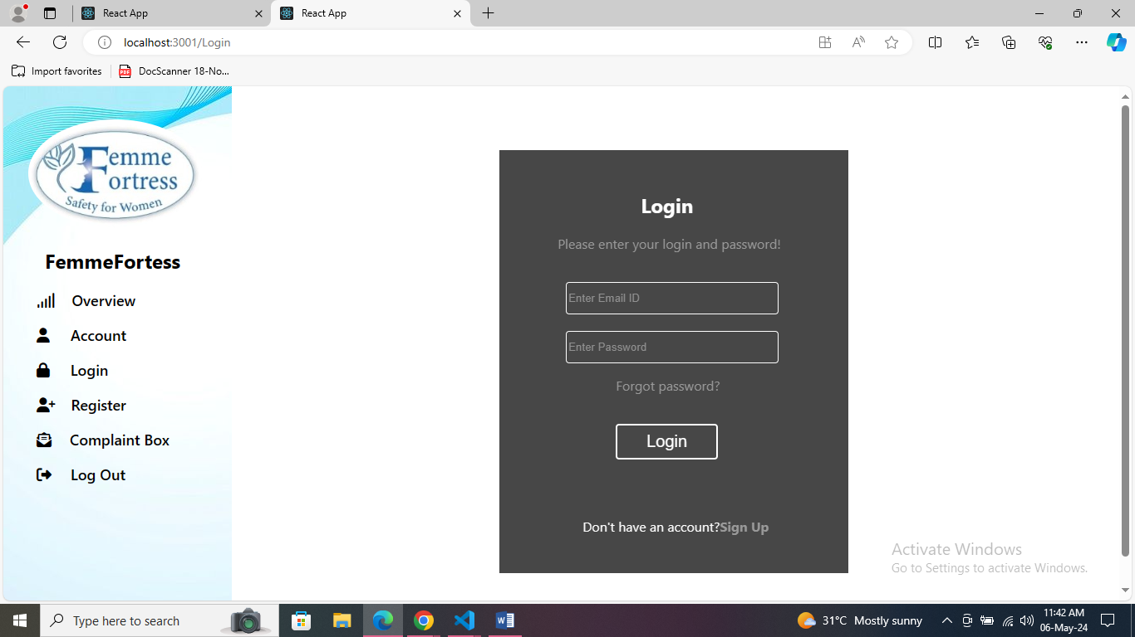
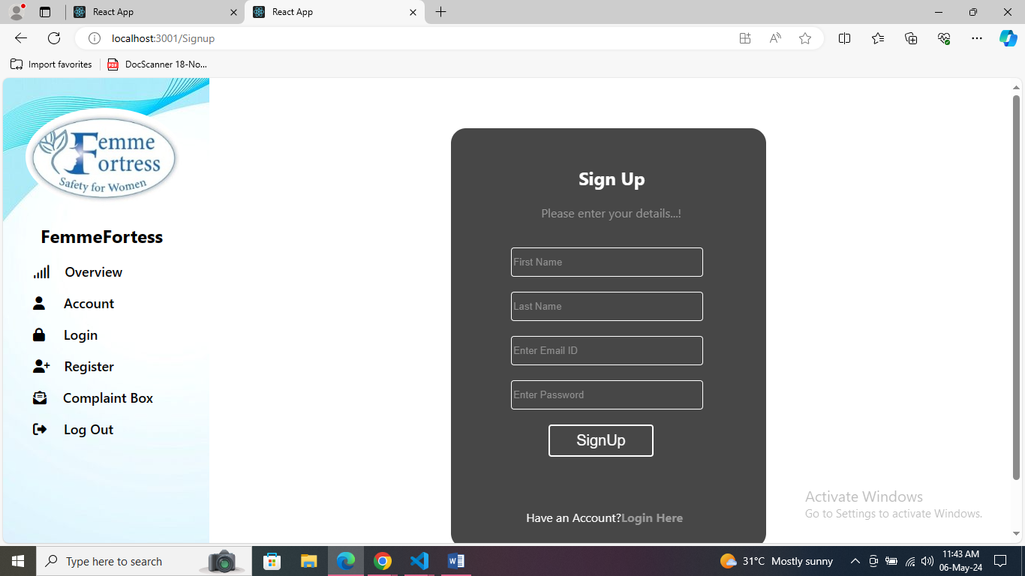
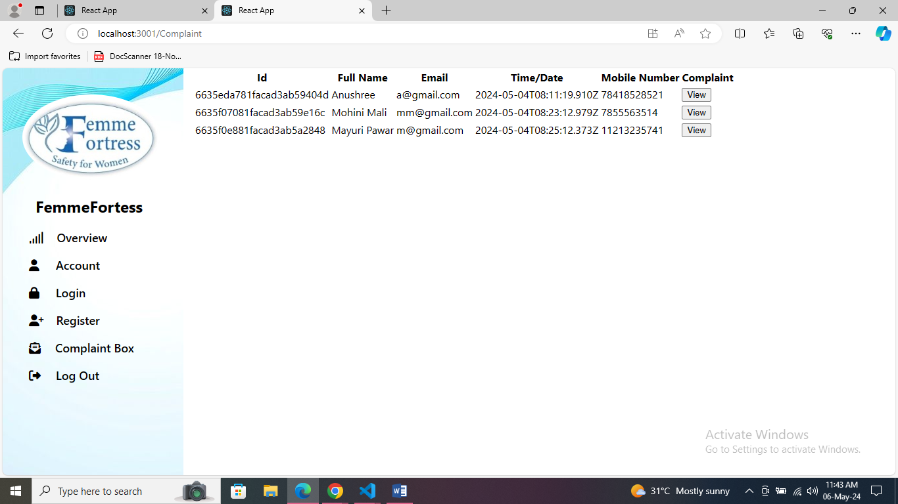

Slide 22
Conclusion
FemmeFortress stands as a cornerstone in our mission to ensure women's safety and empowerment. It streamlines the reporting process, offering a user-friendly interface for both students and staff. Security and privacy are paramount, with measures like role-based access control and encryption. Built on the MERN stack, it's scalable for future improvements, reflecting our commitment to fostering inclusivity and mutual respect within our institution.

Slide 23
Bibliography
Google for problem solving.
https://www.w3schools.com
https://react-bootstrap.netlify.app
https://www.npmjs.com
https://www.mongodb.com
https://nodejs.org/en

